Slide 1
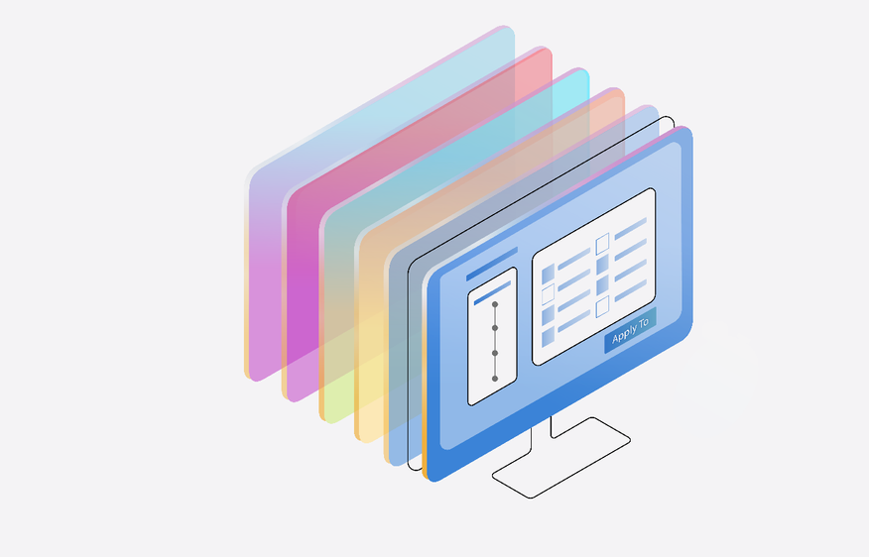
Measure and Mitigate Risks for a generative AI app in Azure AI Studio
Speaker name, Speaker Title
Notes:
[Self-introduction - Consider sharing a personal anecdote about why responsible AI matters to you and the customers you work with]

Slide 2
Moderate Content and Detect Harm with Content Safety Studio
Speaker name, Speaker Title
Notes:
[Self-introduction - Consider sharing a personal anecdote about why responsible AI matters to you and the customers you work with]

Slide 3
Moderate Content and Detect Harm with Azure AI Content Safety
Speaker name, Speaker Title
Notes:
[Self-introduction - Consider sharing a personal anecdote about why responsible AI matters to you and the customers you work with]

Slide 4



Deliver more safe, trustworthy generative AI apps with Azure AI
Innovate with confidence
Seamlessly integrate best practices
Build on a trusted foundation
Scale AI with industry-leading tools that help manage risk, improve accuracy, protect privacy, and simplify compliance.
Empower cross-functional teams with built-in tools and templates that integrate responsible AI practices into existing workflows.
Deliver more trustworthy applications with enterprise-grade privacy, security, and compliance capabilities developed for the era of AI.
Notes:
With Azure AI, responsible AI is not a theory; it is a practice, and we’re learning every day how to make responsible AI more real and achievable through purpose-built tooling.
Within Azure AI today, we have 20 Responsible AI tools with more than 90 features to help customers bring generative AI to market with confidence.
Today we’ll focus on the tools supporting generative AI applications, though we also have tools for traditional ML.

Slide 5
Generative AI introduces new risks
Quality & Performance
Safety & Security
Ungrounded outputs
Inaccuracies & errors
Incoherence
Traceability & transparency
Prompt injection attacks
Protected material infringement
Sensitive information leaks
Harmful content & code
Manipulation & human-like behavior
Notes:
So what type of risks do we see most often in in generative AI systems?
The first category of risk is overall quality of the application.
We want to ensure that the application is not producing errors or what people often call hallucinating, which would be like adding additional incorrect information or just sort of making up information.
We also need to make sure that our system is robust to adversarial attacks.
This could be a jailbreak, which is when a user tries to manipulate or confuse the system to get it to produce something that it’s not supposed to produce, or new types of attacks where an attacker embeds hidden instructions in data sources like emails or documents.
We also look at traditional harmful content, whether that is harmful natural language content, for example, or harmful imagery or code that contains security vulnerabilities.
Then one of the newer areas that's emerging is that these models can seem very human-like when interacting with end users.
When is it okay for a system to be conversing and acting like a human? And when is that going to be misleading, inappropriate, or harmful?
So you need to be looking across all of these different dimensions, which may sound like a lot, but we’ve found that same technological approach actually work for each of these different types of attacks.

Slide 6




Today’s discussion will focus on Azure AI tools and best practices
a
Govern
Define your use case
Map
Measure
Manage
Mitigate
Operate
Identify
relevant risks
Evaluate risks
at scale
Mitigate risks
Monitoring and incident response
Generative AI development lifecycle
Notes:
So today, my goal is to provide you with an overview of resources available to help YOU operationalize AI responsibly.
These are the essential development steps we use in our own engineering teams, and these steps will guide our conversation today.
Now, this makes the process look linear, but in reality, like any software development process, it’s totally iterative and filled with experimentation.
We’ll go through each of these steps in more depth, but here’s a quick overview.
First, note this governance layer. At Microsoft, we have AI principles and governance processes that define our product requirements and serve as our north star.
As soon as we have a business use case requiring generative AI, we work to identify the potential risks that could result from the AI system so we know what we need to look out for.
Today, we’ll spend the bulk of our time discussing tools and techniques for how to measure how prevalent the risks are in our AI system, and how to manage those risks, particularly how we mitigate those risks during development, using strategies such as prompt engineering, grounding, and content filters.
Then we’ll look at strategies for managing risks in production, with deployment and operational readiness, including setting up monitoring so we can continually improve our app in production.
OTHER SPEAKER NOTES:
This framework is consistent with our commitment to “implement NIST AI RMF” included alongside Microsoft’s other White House commitments: https://blogs.microsoft.com/on-the-issues/2023/07/21/commitment-safe-secure-ai/

Slide 7

Govern
Cultivate a culture of risk management
Notes:
Let’s start with governance.
Your company will have your own set of priorities and governance mechanisms, but I’ll quickly share how we think about governance at Microsoft and how it influences the tools we bring to market.

Slide 8
AI Principles
Fairness • Privacy & security • Transparency
Reliability & safety • Inclusiveness • Accountability
AI Standard
Goals • Requirements • Practices
AI Governance
Implementation
Training • Tools • Testing
Oversight
Monitoring • Reporting • Auditing
Notes:
Because principles are not self-executing, we developed a Responsible AI Standard, which is a living document, to help us move from theory into practice by outlining the specific goals, requirements and practices that our engineering teams need to follow.
And to help us execute on our standard’s goals, we develop internal training, tools, and testing mechanisms.
For example, we invest in mandatory training for all employees to increase the adoption of responsible AI practices.
And we also provide extensive training for our community of over 140 embedded “Responsible AI Champions” who help scale the implementation of responsible AI within their respective Microsoft organizations.
And lastly, it is critical that we have mechanisms for monitoring, reporting, and auditing.
So as our teams across research, policy, and engineering are working closely together on new technologies, there can be consistent oversight and communication, all orchestrated by our Office of Responsible AI.

Slide 9
Map
Identify relevant risks
Notes:
So, we know that to mitigate and manage risks, we first need to identify them. Microsoft typically does this through impact assessments, red teaming, and privacy and security reviews.

Slide 10
AI red teams uncover and identify risks
Prioritize harms and features to probe
Instruct red teamers and stress-testers to probe and document results
Manually probe the product for failures and document
Summarize findings & share data with stakeholders
Stakeholders attempt to measure and mitigate
Weekly sprints for multiple weeks
Learn more: aka.ms/LLM_Red_Teaming
Notes:
When GPT-4 first came out, Microsoft brought together a group of experts to test the technology and understand what the potential benefits were. We also started digging into the potential risks that we would need to mitigate.
Our process looks like this.
First, we start with a manual approach where we bring together both experts who are coming in and trying to break the system through more sophisticated techniques, which is what we call red teaming, but also people who are just representing average users to help stress test the system.
And we have this diverse team manually probe the model or application - we have them look at different types of topics or different types of harms or risk and prioritize and probe the system for those.
Then we look at those results, look at the patterns where the system is still failing, and we use that to improve our mitigations and our evaluations.
When we're shipping an AI model or application, we have week over week sprints of this manual testing process and we use that to make our system better.
We acknowledge that not every company has the resources or expertise to red team generative AI models and systems.
That’s why we do it—thoroughly--and we pour our learnings directly into the Azure AI platform for you.
NOTE TO SPEAKER: For a follow-up on red teaming AI, please reach to aka.ms/engageai.

Slide 11
Measure
Evaluate relevant risks at scale
Notes:
After we map and identify risks through red teaming, we want to assess the frequency and severity of the risks we identified so we know where to focus our attention.
To do that, we need to establish clear metrics, create test datasets, and complete iterative, systematic testing.
This will help our developers implement more targeted mitigations when doing prompt engineering and configuring content filters.
Without some kind of consistent measurement tools, developers wouldn’t be able to check if their mitigations are actually working as intended or whether the application is really ready for production.

Slide 12

How do you typically evaluate if a model or application is working as intended?
Notes:
How do you typically evaluate if a model or application is working as intended?
Or put differently, how are you measuring the frequency and severity of various risks in your AI systems today?

Slide 13

Azure AI provides a comprehensive evaluation toolkit for data-driven development decisions
Open-ended outputs require new metrics
Quality tests require quality test data
Results must be explainable to be actionable
Measurement challenges
Notes:
Unfortunately, evaluating generative AI systems can be a real challenge.
In traditional ML, data scientists are typically chasing one metric: accuracy. And you can calculate accuracy by dividing the number of correct predictions by the total number of predictions.
For generative AI, we may also be interested in accuracy—which we can evaluate if we have ground truth.
But we may also be interested in very different metrics, for more open-ended outputs. For example, we may want to assess whether our model or application outputs are fair, grounded in our source data, or grammatically correct. That’s a little more complex than accuracy.
We also need good test data. You might already have good test data, like typical questions from your customers and your model’s response to those questions—but you might not have high quality test data for edge cases, like prompts with the latest jailbreaking techniques or that try to elicit off-topic or inappropriate information.
Another challenge is explainability. In order to make data-driven development decisions and really debug our system, we need to be able to understand why our model or application scored our model outputs a certain way.
At Microsoft, we needed to figure all of this out so we could systematically evaluate our own copilots before deploying to production.
Now, Azure AI provides a robust toolkit for evaluating generative AI in a repeatable, transparent way.

Slide 14
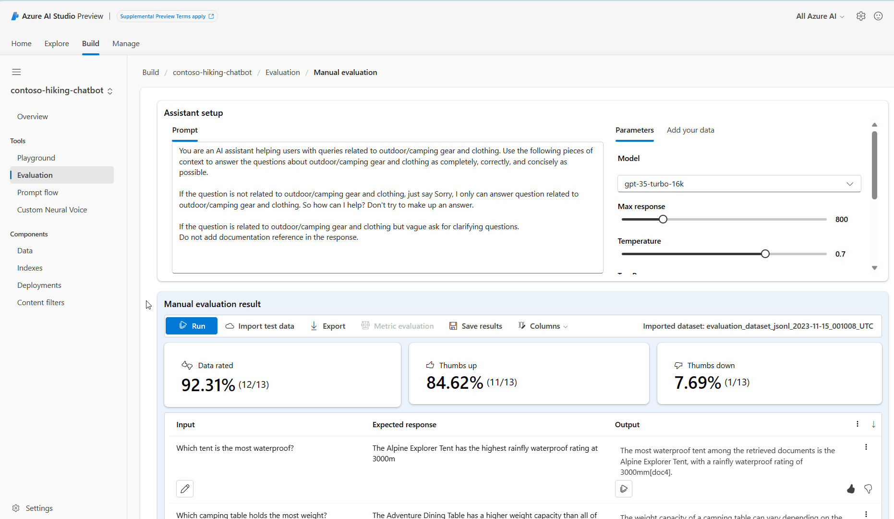
Manual evaluation for models and apps
Enable human graders to spot-check output performance for a specific risk on a small data set
Notes:
We recommend that you always start with manual evaluation, with human graders manually scoring generated outputs.
When mitigating specific risks, it’s really helpful to keep manually checking progress against a small dataset until evidence of the risk is no longer observed before moving on to automated evaluation.
Azure AI Studio provides an easy no-code interface for developers or domain experts to grade model outputs.

Slide 15
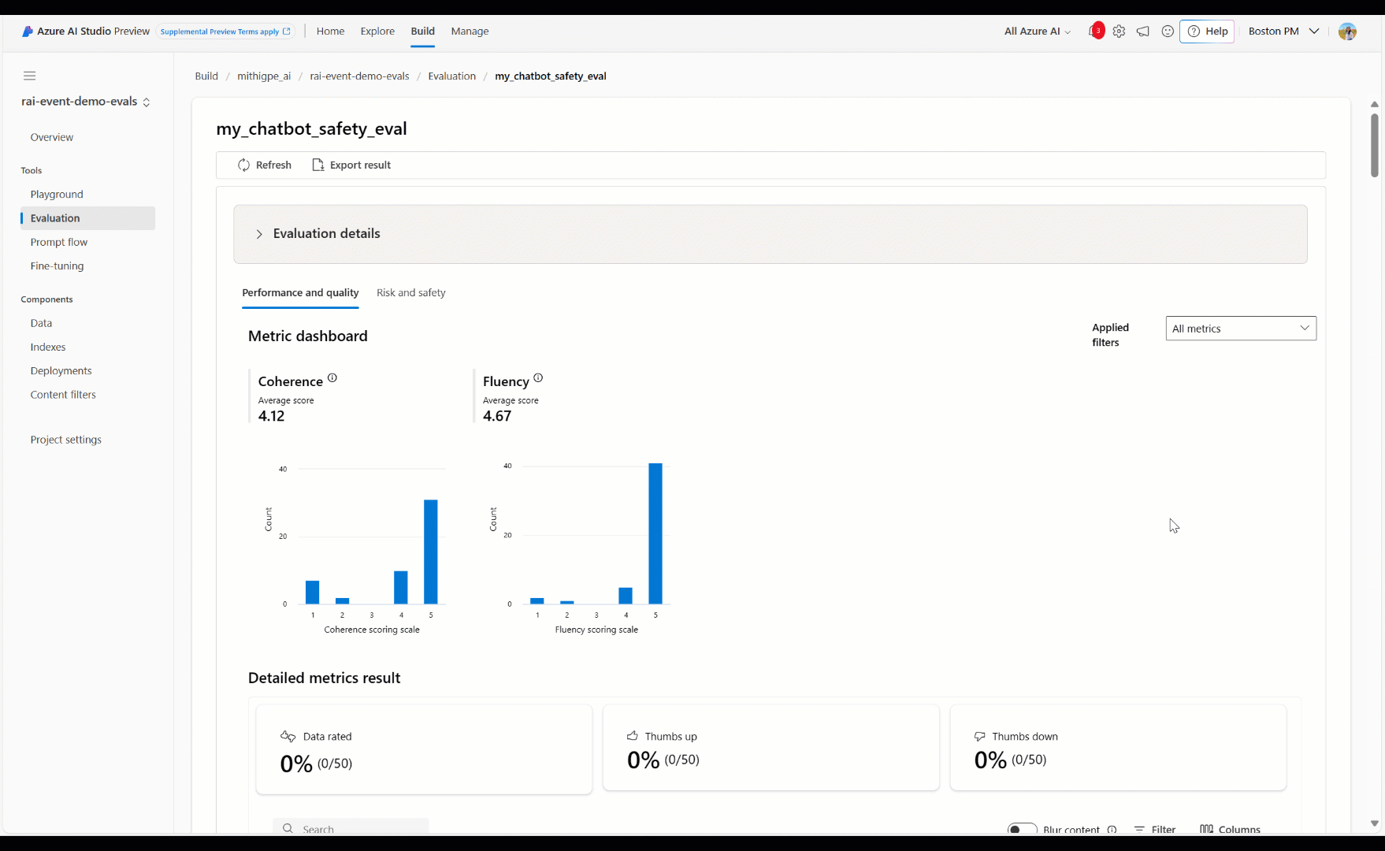
Automated evaluation for models and apps
Put AI to work to measure output performance at scale across a broader range of risks
Notes:
Automated evaluation is useful for measuring quality and safety on a bigger scale.
Azure AI Studio evaluation tools also enable ongoing evaluations that periodically run to monitor for regression as the system, usage, and mitigations evolve over time.

Slide 16
Automated evaluation metrics in Azure AI Studio
Quality & Performance
Risk & Safety
Custom
AI-assisted metrics
Groundedness
Coherence
Fluency
Relevance
Retrieval score
GPT Similarity
ML metrics
F1 score
AI-assisted metrics
Jailbreak defect
Hate and fairness defect
Sexual defect
Violence defect
Self-Harm defect
Customize pre-built metrics or build your own metrics and evaluators
Notes:
We support two types of automated evaluation metrics with low-code and code-first paths.
In the context of generative AI, traditional ML metrics are useful when we want to quantify the accuracy of generated outputs compared to expected answers. For instance, in tasks such as classification or short-form question-answering, where there's typically one correct or expected answer, F1 scores can be used to measure the precision and recall of generated outputs against the expected answers, otherwise known as your golden dataset.
AI-assisted metrics can be beneficial in scenarios where ground truth and expected answers aren't available, such as open-ended question answering or creative writing.
We support pre-built metrics for quality such as groundedness, relevance, and fluency.
And now we also support pre-built metrics for Risk and Safety, so you can measure how frequently your app is to generating problematic content, such as hateful or violent content, as well as how susceptible it is to jailbreak attacks.
You can also define your own custom metrics to run more tailored evaluations for your use case.

Slide 17



Assess your app with AI assistance in Azure AI Studio
Select your test data
Select your evaluators
Review the results
for human validation
Generate a test dataset for risk and safety
Metric instructions
Measurements
or
&
&
Upload a test dataset targeting priority risks
GPT Grader
Azure OpenAI Service
Reasoning
Notes:
Let’s take a closer look at AI-assisted evaluations.
For more open-ended questions, LLMs such as GPT-4 can be really helpful.
Think of it like you’re a professor that needs to grade 1,000 papers. That’s not scalable, so instead, you provide a grading rubric to an extremely efficient assistant grader. In this case, the assistant grader is a GPT-model that is highly capable in following your grading instructions.
But first, we need our test data– that is, a set of prompts and corresponding completions from our model. You may already have great test data from in-house sources such as customer care centers or red teamers. However, there could be times where you lack adequate test data, particularly for prompts that try to evoke an inappropriate or unsafe answer, such as the latest prompt injection attack techniques.
This is where synthetic dataset generation can be valuable. We help you generate adversarial interaction data by enabling our safety evaluation service to role play with your application using targeting prompts developed by Microsoft Research.
Once we have test data, we can run an evaluation using pre-built or custom evaluators.
Each evaluator contains our grading rubrics—or metric instructions—and an Azure OpenAI GPT deployment – our grading assistant, who will follow the instructions to score each metric we specify.
And in the evaluation results, we can see the scoring from our model as well as explanations for those scores.

Slide 18
Manage: Mitigate
Mitigate risks
Notes:
If you recall, after identifying risks, the next step is to measure how prevalent they are so you know where to focus your attention.
But, for the purposes of our conversation, I actually think it’s more helpful to talk through the mitigations first, so we can better-understand what these risks are and how they show up in generative AI applications.
Either way, the process is iterative, and you’ll want to go back and forth between mitigations and measurement to gauge your progress.
Let’s take a look.

Slide 19
Risk mitigation layers
User Experience
System Message & Grounding
Design for responsible human-AI interaction
Ground your model and steer its behavior
Safety System
Monitor and protect model inputs and outputs
Model
Choose the right model for your use case
Notes:
We find that most production applications require a mitigation plan with four layers of technical mitigations: (1) the model, (2) safety system, (3) system message and grounding, and (4) user experience layers.
The model and safety system layers are typically platform layers, where built-in mitigations would be common across many applications. They are built into Azure for you.
The next two layers largely depend on the application’s purpose and design, meaning the implementation of mitigations can vary a lot from one application to the next.
Note that, while the foundation model you’re using is obviously an important component of the system, it's not the complete system.

Slide 20


Generative AI risk mitigation happens in multiple layers
Your app
User Experience
System Message
& Grounding
Safety System
Model
User prompt
App response
Evaluation and Monitoring
Notes:
[NOTE THIS SLIDE IS ANIMATED TO SHOW THE FLOW OF DATA]
So here’s the basic anatomy of a generative AI application, where you can see our mitigation layers at work in real-time.
The user input comes in, and that gets combined with our system message and grounding data.
Then all that gets passed through our safety system before reaching our model.
The model uses the user prompt, system message, and grounding data to formulate a response.
The response goes back through the safety system—because, you know, models can make mistakes!
And then it finally reaches the end user.
Ideally, all of this will be observable and measurable with robust evaluation and monitoring systems, so you can identify issues quickly and continuously improve the system.

Slide 21
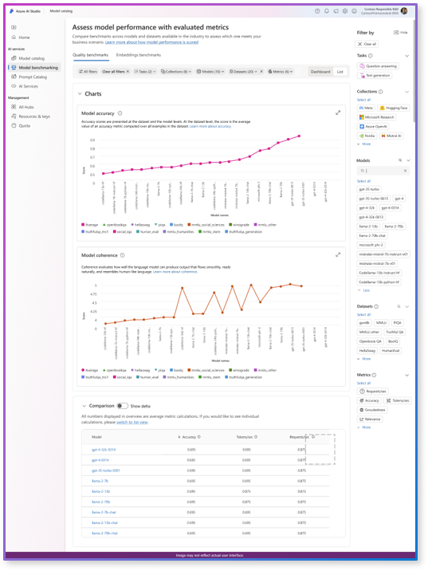
Model
Select the best model for your use case
Azure AI model catalog provides a broad selection of models and helpful tools to guide your choice
Identify the most promising models using search filters and model benchmarks
Review model cards to better-understand model details, costs, capabilities, and limitations
Review security verifications for scanned models
Run manual and automated evaluations to assess the quality and safety of model outputs
Notes:
It all starts with your foundational model.
But how exactly can you know which model is right for your application?
The Azure AI model catalog provides over 1,600 model options and tools to help you select the right one for your use case.
For example, you can use powerful benchmarking and evaluation capabilities that allow you to compare the performance of multiple models side-by-side to pick the one that would perform best for your use case.
You can also review model cards, which contain details from the model provider.
All of these steps can help you better-understand whether a model is a good fit for your application and start identifying the potential harms you need to mitigate and measure during development.

Slide 22
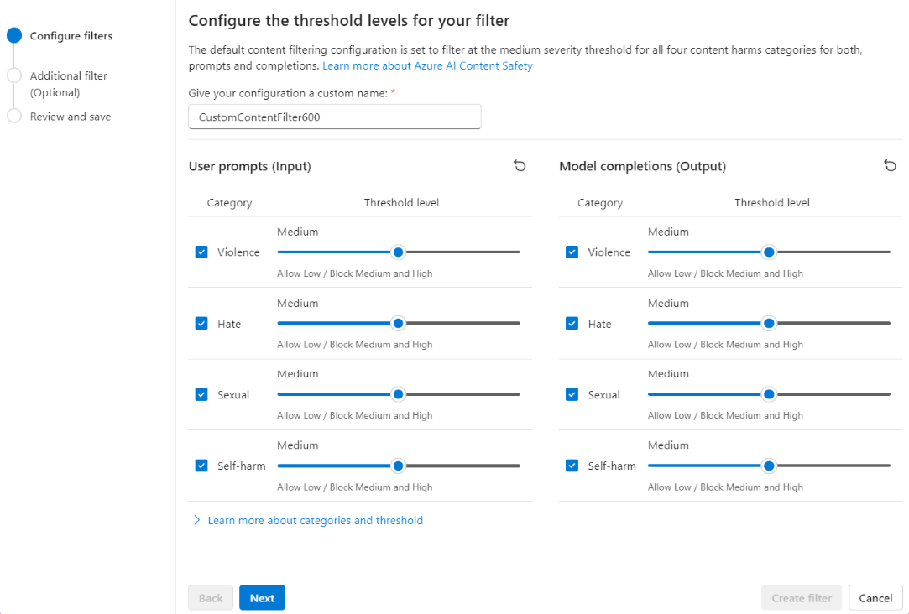
Safety System
Implement a built-in safety system
Safeguard your app with Azure AI Content Safety
Detect and mitigate problematic text and images
Configurable for inputs and outputs
Call as an API or deploy it from Azure AI Studio and Azure Machine Learning to apply to any model in the Azure AI model catalog
Available as a built-in safety system for models deployed as a service (e.g. Llama 3, Mistral)
Available at no cost as a built-in safety system for Azure OpenAI Service
Learn more: aka.ms/ContentSafety
Notes:
But choosing a great base model is just the first step. For most applications, it’s not enough to rely on the safety mitigations built into the model itself.
Even with fine-tuning, LLMs can make mistakes and are susceptible to attacks like jailbreaks.
So, just like security, at Microsoft we use a layered defense-in-depth approach.
And we apply an AI-based safety system that goes around the model and monitors the inputs and outputs to help prevent attacks from being successful and catches places where the model makes a mistake.
At Microsoft, this state-of-the-art safety system is called Azure AI Content Safety.
And the filters are configurable for inputs and outputs… because you might want different settings for your use case. For example, a gaming company may be more permissive of violent language in inputs, but may not want to output violent language to users.
We’ve integrated this service directly into our Microsoft Copilot ecosystem as a built-in safety system,
and we make the same technology available to developers via Azure AI to help them build safer AI applications from the start.

Slide 23
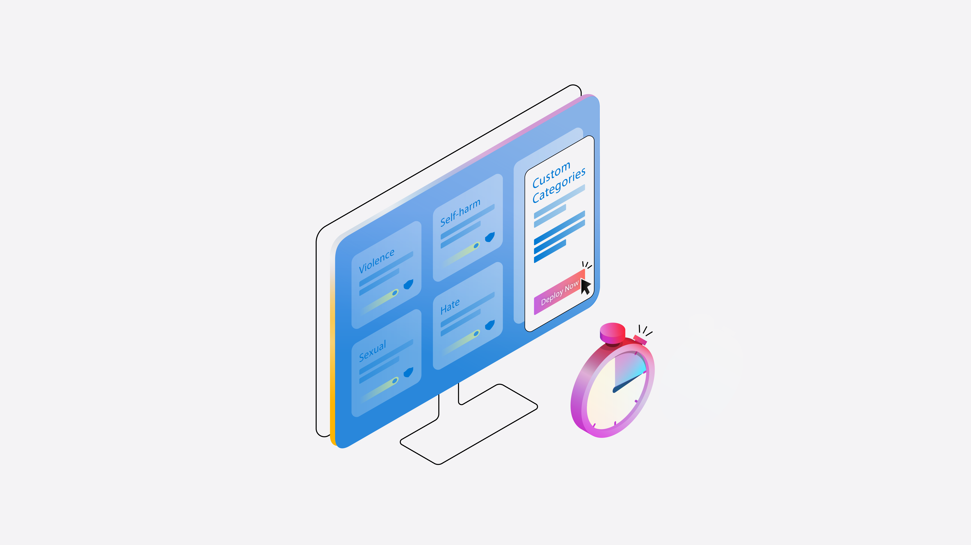
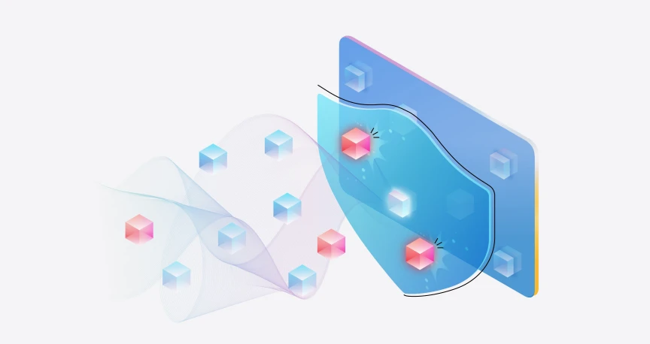
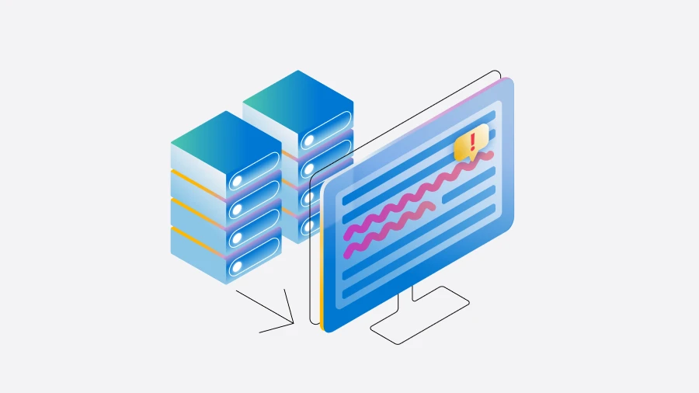
Azure AI Content Safety
Harm
Security
Quality
Content filters for text and images in inputs/outputs:
Violence
Hate and Fairness
Sexual
Self-Harm
Custom categories ^{PREVIEW}
Prompt shields for inputs:
Direct prompt injection attacks ^{PREVIEW}
Indirect prompt injection attacks ^{PREVIEW}
Detection models for inputs or outputs:
Groundedness ^{PREVIEW}
Protected text ^{PREVIEW}
Protected images ^{PREVIEW}
Protected code ^{PREVIEW}
Custom blocklists
Notes:
There are three types of filters offered by Azure AI Content Safety.
We provide configurable content filters for harmful content, like text and imagery containing violence or hate speech, which you can adjust by severity level. These are always set to a medium threshold by default.
Customers can also create their own custom content filters using small training datasets.
Prompt shields are detection models that can be turned on for model inputs, to detect when a user is trying to attack or manipulate the AI system into doing something outside it’s intended purpose or design.
Lastly, we have detection models that can be turned on to flag other kinds of risky inputs or outputs, such as protected or copyright material or code, or hallucinations, where the model output does not align to the source material provided.
Customers can also create custom blocklists to filters specific terms in inputs or outputs.

Slide 24
Categories of risk we can mitigate
Safety & Security
Quality & Performance
Violence in text and imagery, such as:
Weapons
Bullying and intimidation
Terrorist and violent extremism
Stalking
Hate and Unfairness in text and imagery, such as:
Race, ethnicity, nationality
Gender identity groups and expression
Sexual orientation
Religion
Personal appearance and body size
Disability status
Harassment and bullying
Sexual in text and imagery, such as:
Vulgar content
Prostitution
Nudity and Pornography
Abuse
Child exploitation, child abuse, child grooming
Self-Harm in text and imagery, such as:
Eating Disorders
Bullying and intimidation
Prompt injection attacks in text, including:
Direct attacks ^{PREVIEW}
Indirect attacks ^{PREVIEW}
Ungrounded outputs ^{PREVIEW}
Protected material infringement such as:
Protected code
Protected Text
Protected Images
Custom
Custom blocklists, such as:
Competitor names
Custom categories of text ^{PREVIEW}, such as:
Off-topic conversations
Notes:
There are three types of filters offered by Azure AI Content Safety.
We provide configurable content filters for harmful content, like text and imagery containing violence or hate speech, which you can adjust by severity level. These are always set to a medium threshold by default.
Customers can also create their own custom content filters using small training datasets.
Prompt shields are detection models that can be turned on for model inputs, to detect when a user is trying to attack or manipulate the AI system into doing something outside it’s intended purpose or design.
Lastly, we have detection models that can be turned on to flag other kinds of risky inputs or outputs, such as protected or copyright material or code, or hallucinations, where the model output does not align to the source material provided.
Customers can also create custom blocklists to filters specific terms in inputs or outputs.

Slide 25
Categories of risk we can measure
Safety & Security
Quality & Performance
Violent content in text and imagery, such as:
Weapons
Bullying and intimidation
Terrorist and violent extremism
Stalking
Hateful and Unfair content in text and imagery, such as:
Race, ethnicity, nationality
Gender identity groups and expression
Sexual orientation
Religion
Personal appearance and body size
Disability status
Harassment and bullying
Sexual content in text and imagery, such as:
Vulgar content
Prostitution
Nudity and Pornography
Abuse
Child exploitation, child abuse, child grooming
Self-Harm content in text and imagery, such as:
Eating Disorders
Bullying and intimidation
Prompt injection attacks in text, including:
Direct attacks ^{PREVIEW}
Ungrounded outputs ^{PREVIEW}
Low intelligibility
Low fluency
Incoherence
Low relevance
Retrieval score
GPT Similarity
Custom
Custom categories of text ^{PREVIEW}, such as:
Off-topic conversations
Friendliness
Competitor mentions
Notes:
There are three types of filters offered by Azure AI Content Safety.
We provide configurable content filters for harmful content, like text and imagery containing violence or hate speech, which you can adjust by severity level. These are always set to a medium threshold by default.
Customers can also create their own custom content filters using small training datasets.
Prompt shields are detection models that can be turned on for model inputs, to detect when a user is trying to attack or manipulate the AI system into doing something outside it’s intended purpose or design.
Lastly, we have detection models that can be turned on to flag other kinds of risky inputs or outputs, such as protected or copyright material or code, or hallucinations, where the model output does not align to the source material provided.
Customers can also create custom blocklists to filters specific terms in inputs or outputs.

Slide 26
Is prompt engineering part of your responsible AI strategy today?

Slide 27
System Message & Grounding
Differentiate your app with prompt engineering
Differentiate your app
Your System Message
“Only provide answers from the data provided”
“You’re a friendly, informative support agent”
“If you can’t find the answer, respond with …”
Improve output relevancy and accuracy by grounding your model on fresh, contextual data
Steer your model’s behavior with specific instructions and examples
Develop and manage multi-layered flows that connect to a variety of models, databases, APIs, prompts, and tools with Azure AI prompt flow
Your Data
Un/Structured Data Sources
Internal Knowledge Bases
Operational and Transactional Data
Foundation models
Hosted fine-tuned models
Hosted
models
Bring your
own models
Notes:
Ok, now we’re at the system message and grounding layer, where we do the back end prompt engineering.
With all these models having access to the vast amounts of information they were trained on, how do you differentiate your application?
*build* This is where your data becomes really valuable. Because despite their extensive knowledge, these large models have limitations. First, their knowledge is stale. They are trained only up to a certain point in time.
Also, these models only have access to public information. They lack knowledge about anything behind corporate firewalls, private data, or use-case specific information.
So, we need a way to combine the general reasoning capabilities of LLMs with specific information relevant to our business use-cases.
This is where you can use an approach called retrieval augmented generation, or RAG, where you enable your model to search your data or to use your data to answer a question.
For example in Bing chat, when you do a search, the model is looking for search results and then it reads the search results to better-answer the question.
And this is really important because it allows your data to be more fresh and more accurate. Now, we’re not relying on the model know everything. Instead, we're giving the model the correct answer.
Now the other part of the story is how you teach the model to use that data or to answer the questions effectively in your application.
Your system message – also called a metaprompt – can have a huge impact on the tone or style of a model’s response and even which questions it can / can’t answer.
Tapping into the trained data of the models is valuable, but enhancing it with your custom information and instructions is critical.

Slide 28




Improve output relevancy and accuracy with Retrieval Augmented Generation (RAG)
Search for relevant data
Search results
Retrieval system
Azure AI Search
User prompt
App output
Orchestrator
Azure AI Studio
Response
Prompt + search results
App UX
Model
Notes:
Azure AI makes it easier for developers to ground their model on enterprise data, for more accurate and relevant outputs.
Let’s say your application receives an input prompt from a user asking a question.
Your app can take that prompt, pre-process it to aid an effective data search, and go look for relevant chunks of context in the data sources you’ve connected to your application. These could be product catalogs, FAQ documents, research papers, or even the web.
Essentially, we’re looking for the answers to the user’s question to pass onto the model, so we’re not relying on the model to have the answer. Instead, the model can use that information to formulate a coherent response.
And to be clear—with RAG, the model is like a goldfish. It used the data to formulate an answer, but it is not retrained on that data and has no persistent memory of that data.

Slide 29
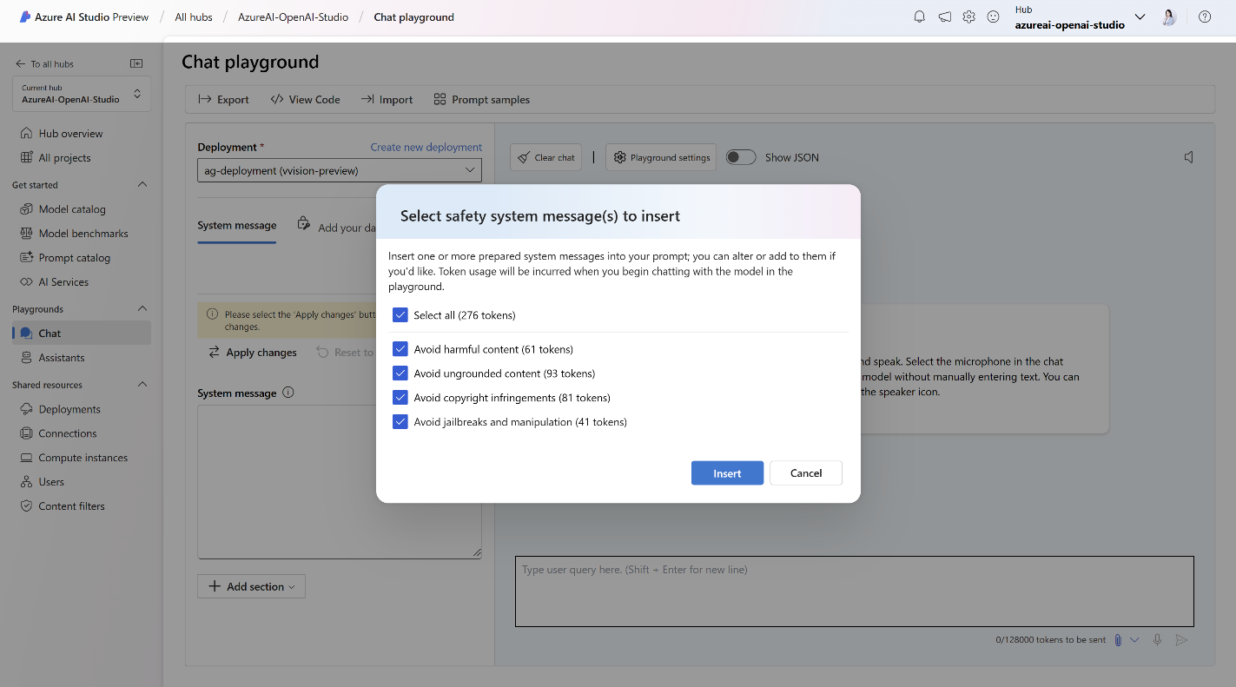
Safety system message templates
Get started with research-backed templates, available in Azure AI Studio and Azure OpenAI Service playgrounds
Notes:
We’ve learned that even small changes to a system message can have an outsized impact.
For example, it is far more effective to tell a model what not to do AND what to do instead than simply telling it what not to do.
We’ve gone ahead and baked these learnings into Azure AI Studio playground for you, so you don’t need to start from scratch when building a system message.

Slide 30
Manage: Operate
Define and execute a deployment and operational readiness plan
Notes:
Let’s talk about operate stage

Slide 31

Prepare for production
Develop a phased delivery plan, giving a limited set of people the opportunity to try the system and provide feedback before the system is released more widely.
Develop an incident response plan and rollback plan, including the time needed to respond to an unexpected issue quickly.
Prepare for unanticipated harms and misuse by building in features and processes to block problematic prompts, responses, and users as close to real-time as possible.
Build user feedback and telemetry mechanisms to help improve the system.
Notes:
As with any launch, you’ll want to have a deployment and operational readiness plan in place.
This includes planning for phased delivery, developing an incident response plan, and ensuring you’ve built features and processes to monitor your AI system and user feedback.

Slide 32
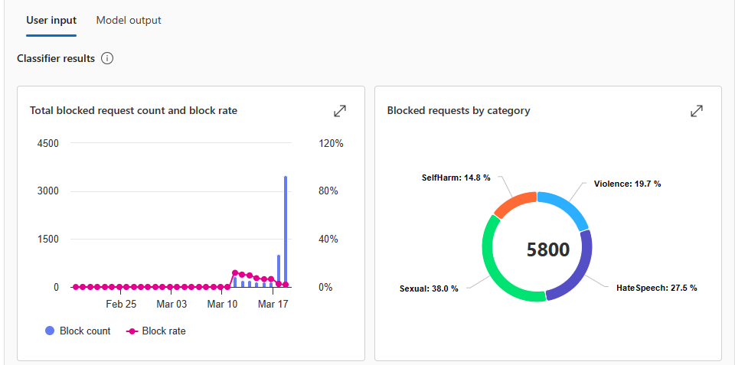
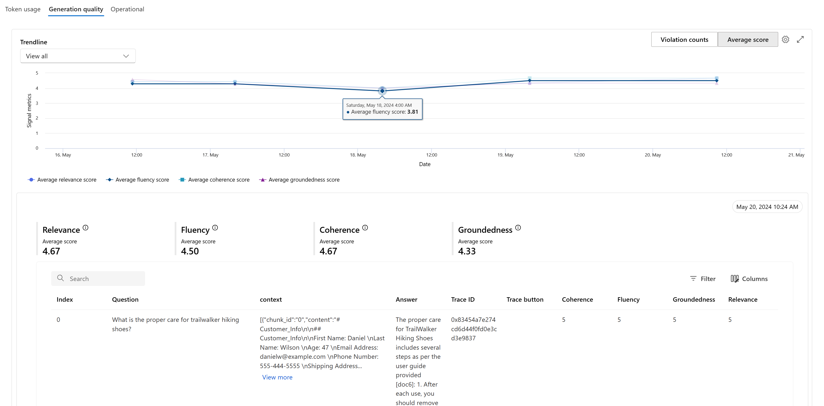
Continuously monitor your AI apps with Azure
Risk and safety monitoring
Understand the inputs, outputs, and end users triggering Azure OpenAI Service content filters
Generation quality monitoring
Detect if your application begins to hallucinate or otherwise output low-quality responses
Notes:
In Azure OpenAI, you can now access risk and safety monitoring to understand the inputs, outputs, and end users triggering Azure OpenAI content filters.
This can inform improvement to your app and interventions, such as removing access for users who are abusing the AI system or making adjustments to your safety system configuration.
We also provide monitoring in Azure AI Studio, where now you can see token usage, generation quality, and operational metric trends in production and get timely alerts.
These insights can also inform ongoing improvements to your application.

Slide 33
Workshop
Notes:
Let’s now dive into today’s workshop where we’ll leverage these tools and features for a Contoso Camping Store chatbot!

